Slide 1
Semester 2 – Week 1
Peer Assisted Learning

Slide 2
PAL Sessions
Welcome Back ☺ Hope your exams went well and you have had a restful break.
A reminder that PAL is now on Monday (15:15) each week from now on, in this room (8W 1.1).
Today, we can’t really go over anything since it’s your first day, but we can talk briefly about what each module will entail.

Slide 3
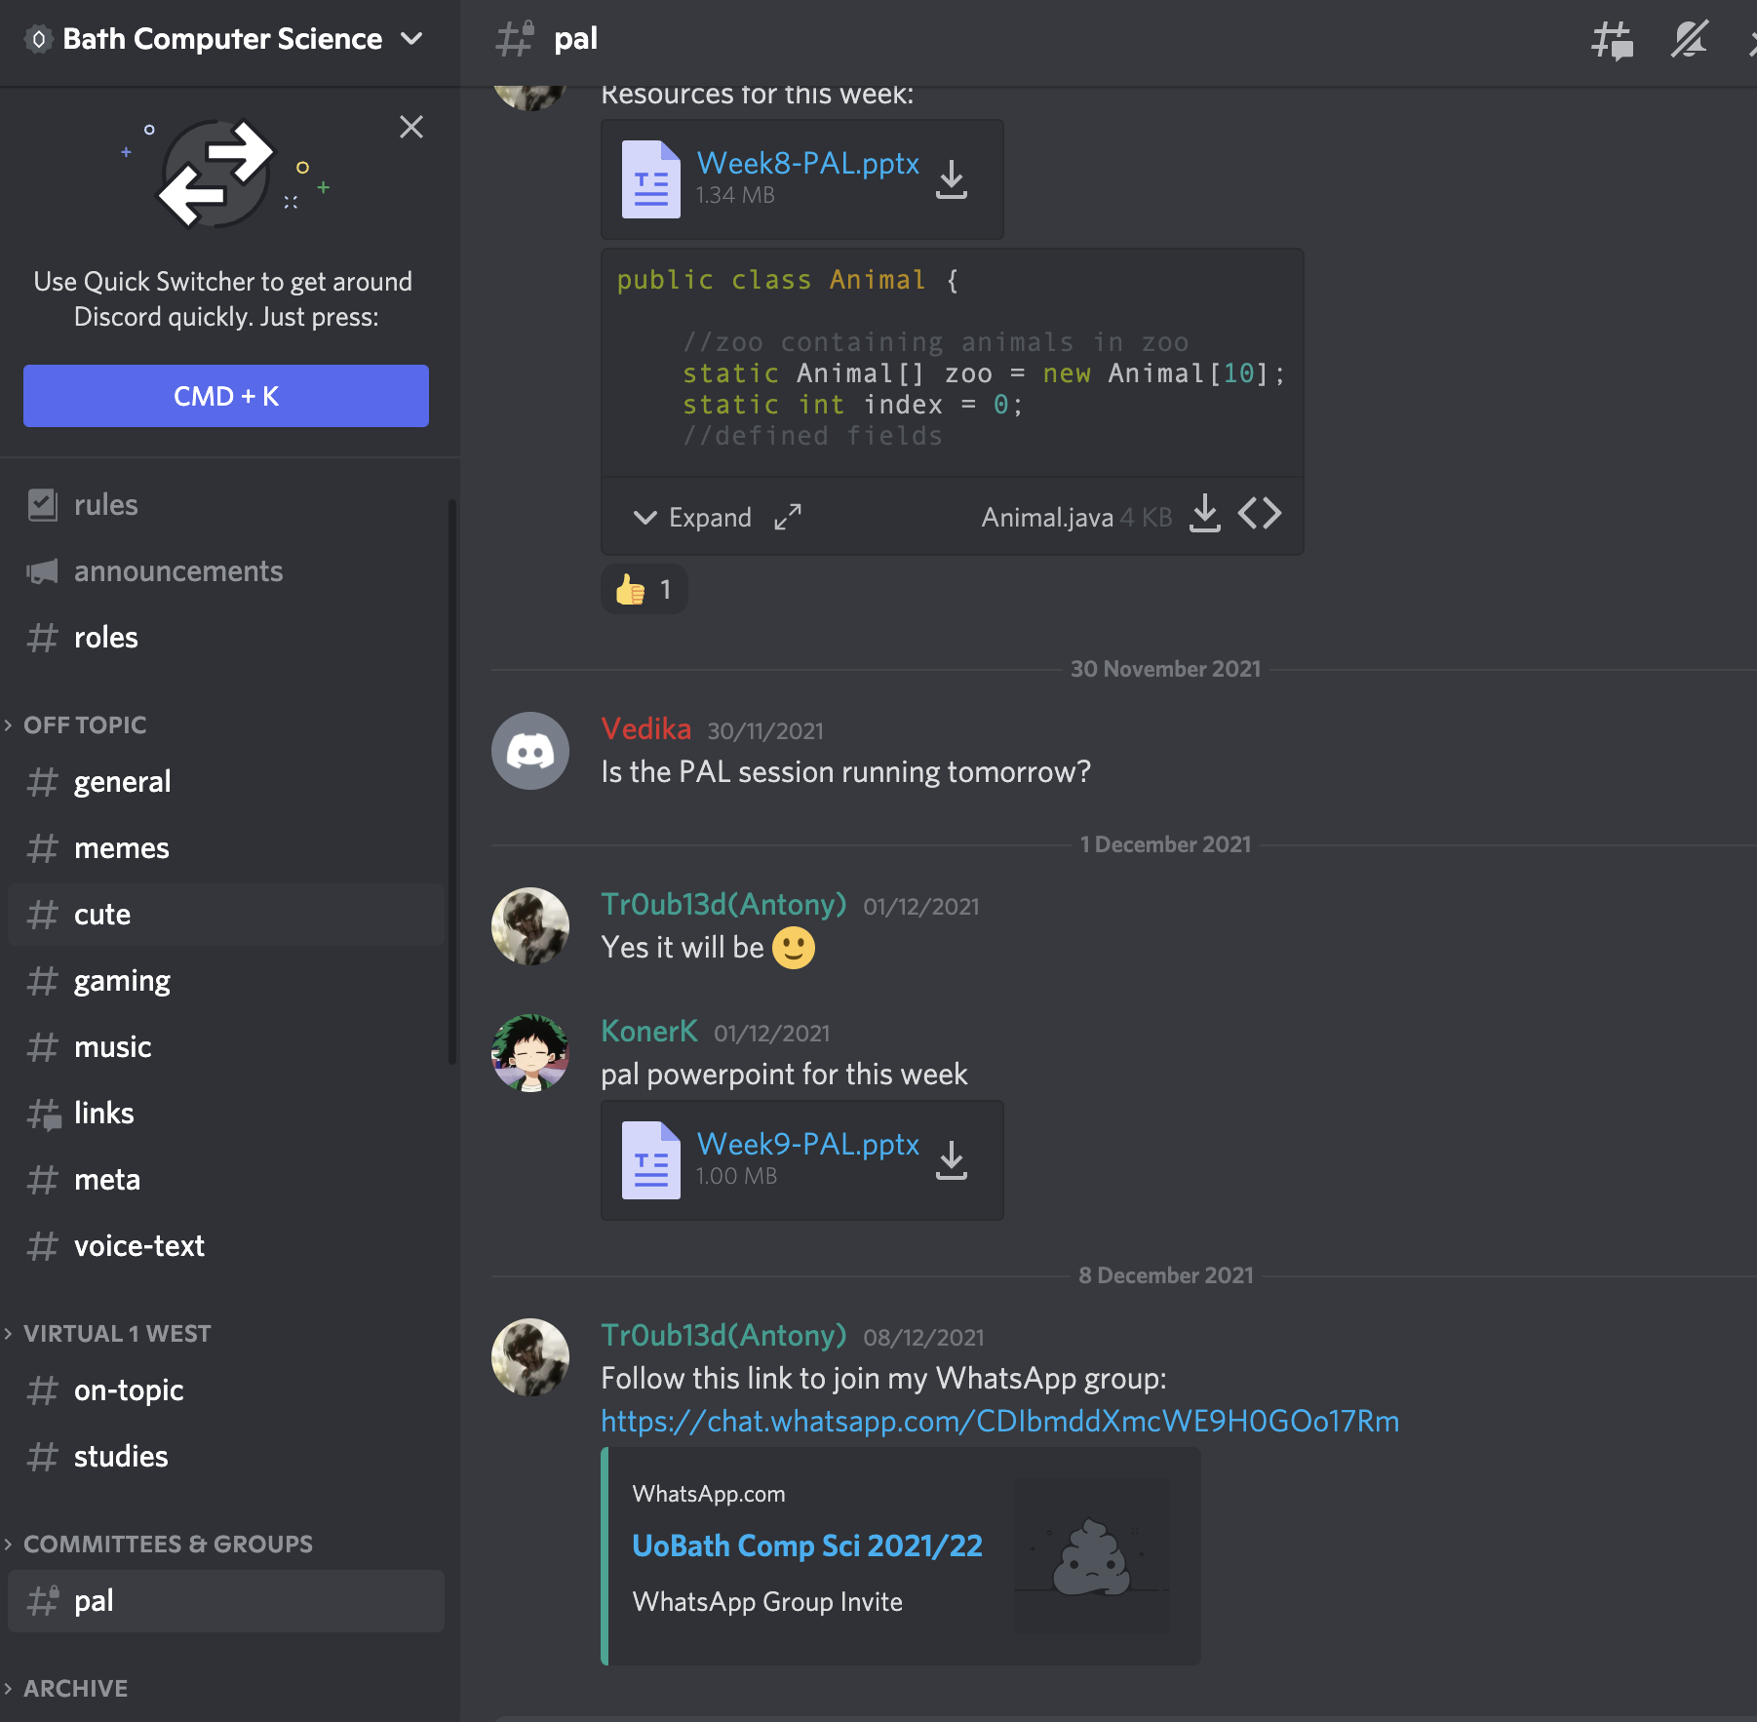
Reminder of PAL Channel
Few Changes:
No survey each week, we’ll take suggestions at the end of pal and feel free to write any topics you want to go over in the PAL discord channel.
We’ll monitor it throughout the week :)

Slide 4
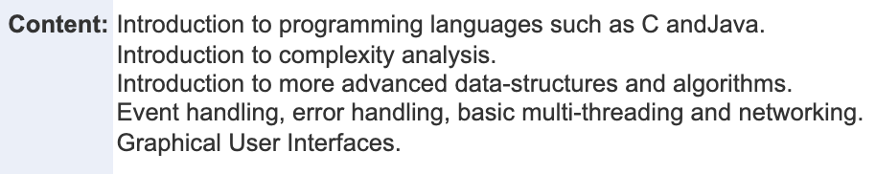
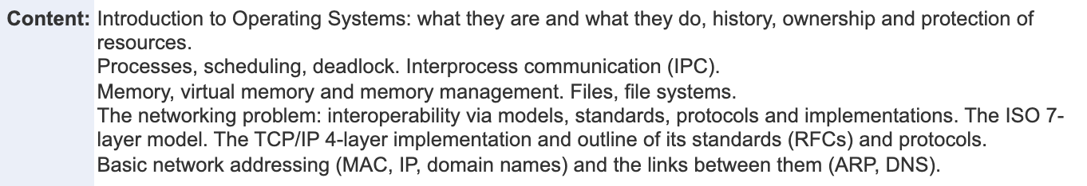
Your Semester Modules - Overview
Principles of Programming 2:
Systems Architecture 2

Slide 5
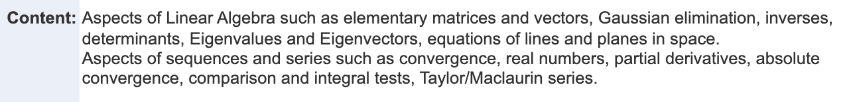
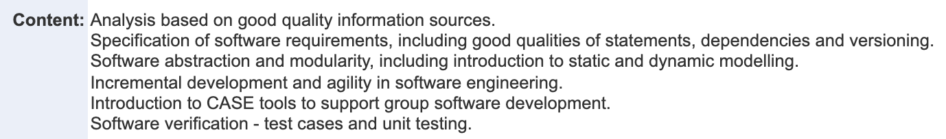
Your Semester Modules - Overview
Mathematics for Computation
Software Processes & Modelling

Slide 6
Your Semester Modules - Overview
AI
AI, of course, will carry on from last semester, but since your course differs we will not be able to go over this in the sessions.
However, still feel free to ask questions in the discord about it; since we still study A.I this year we might be able to help :)

Slide 7
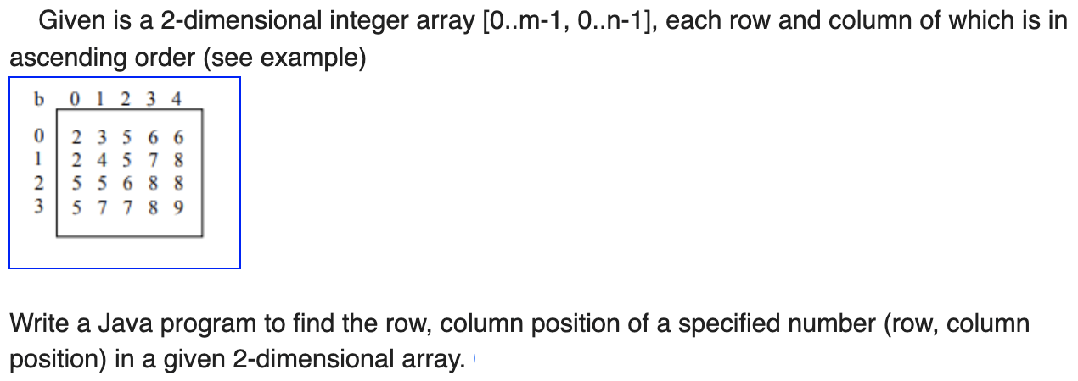
Programming Exercises
1. Given an integer array, find the second largest integer.
2.
3. Palindrome Check: Write a method that detects if a string is a palindrome. (Remember that a palindrome is a word, or any sequence of characters, that reads the same backwards as forwards, such as abba or baab).

Slide 8
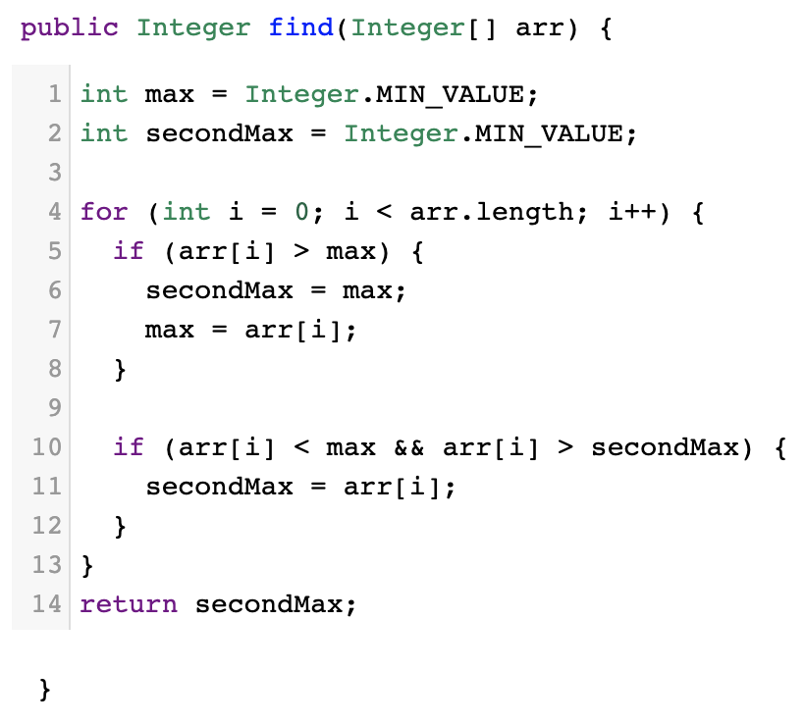
Question 1: Possible Solution

Slide 9
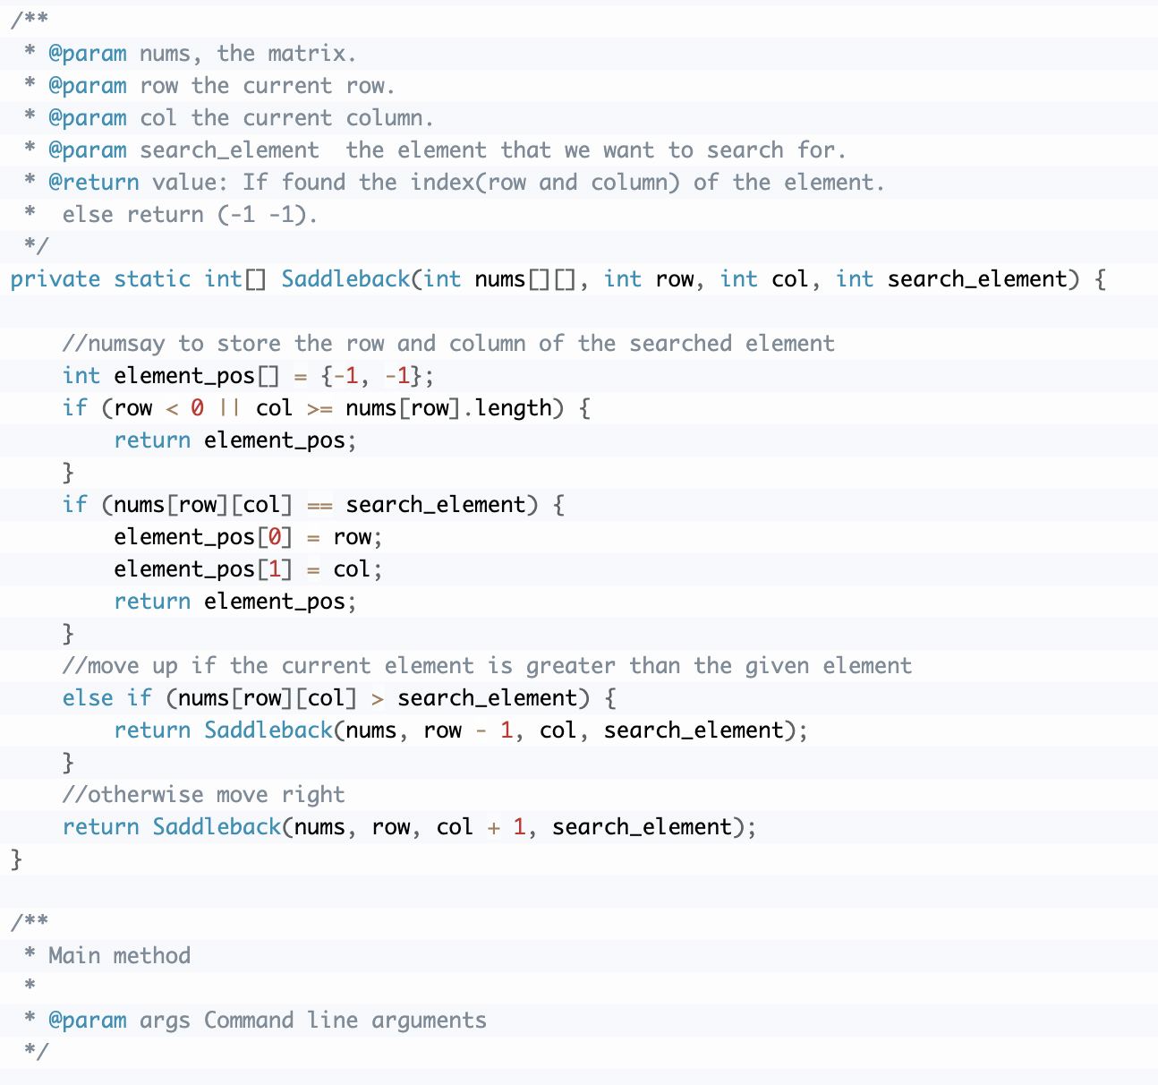
Question 2: Possible Solution

Slide 10
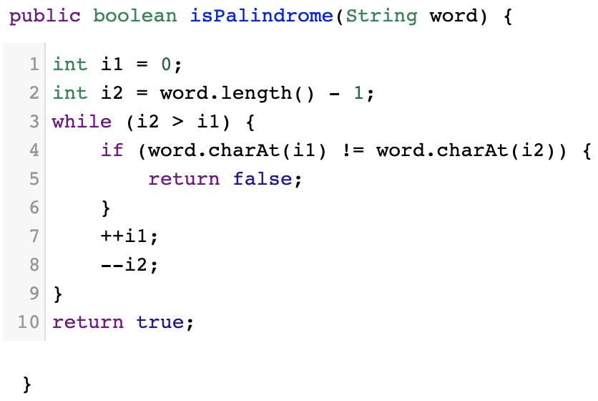
Question 3: Possible Solution

